Slide 1
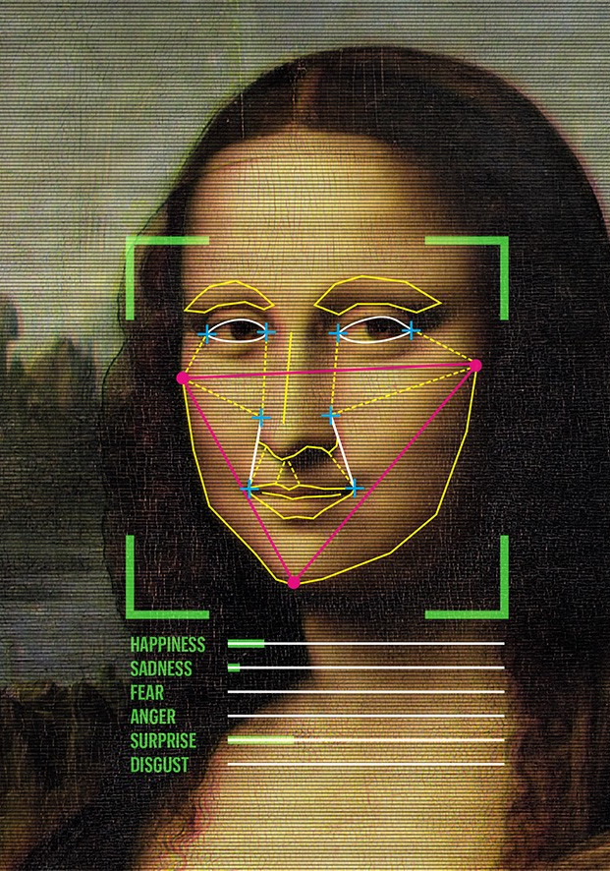
Should facial recognition be regulated?

Slide 2
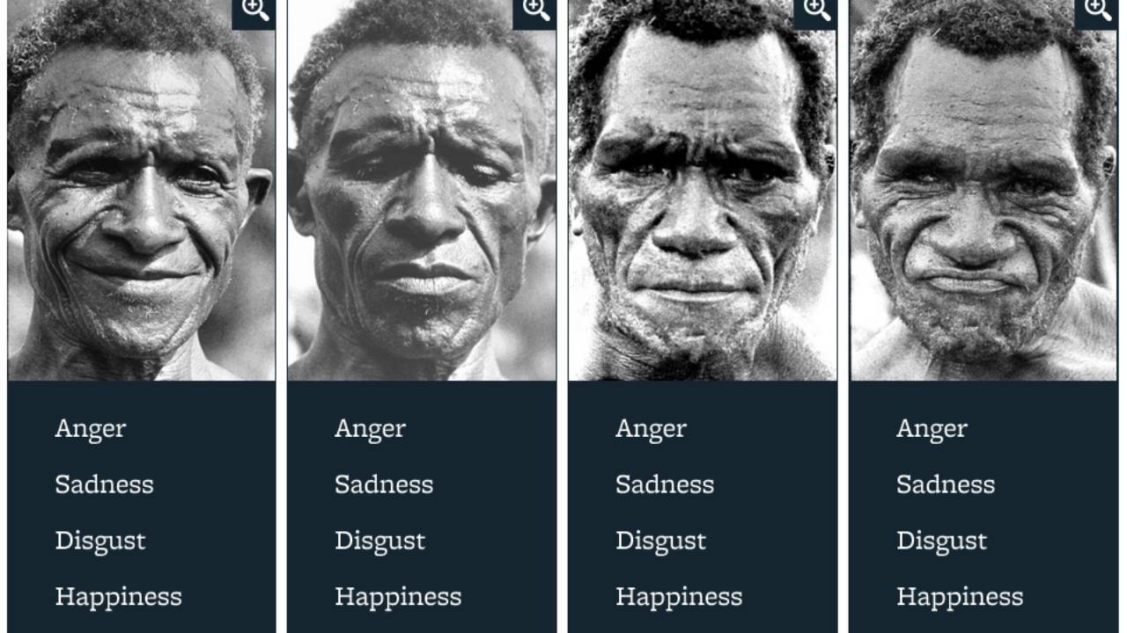

Slide 3
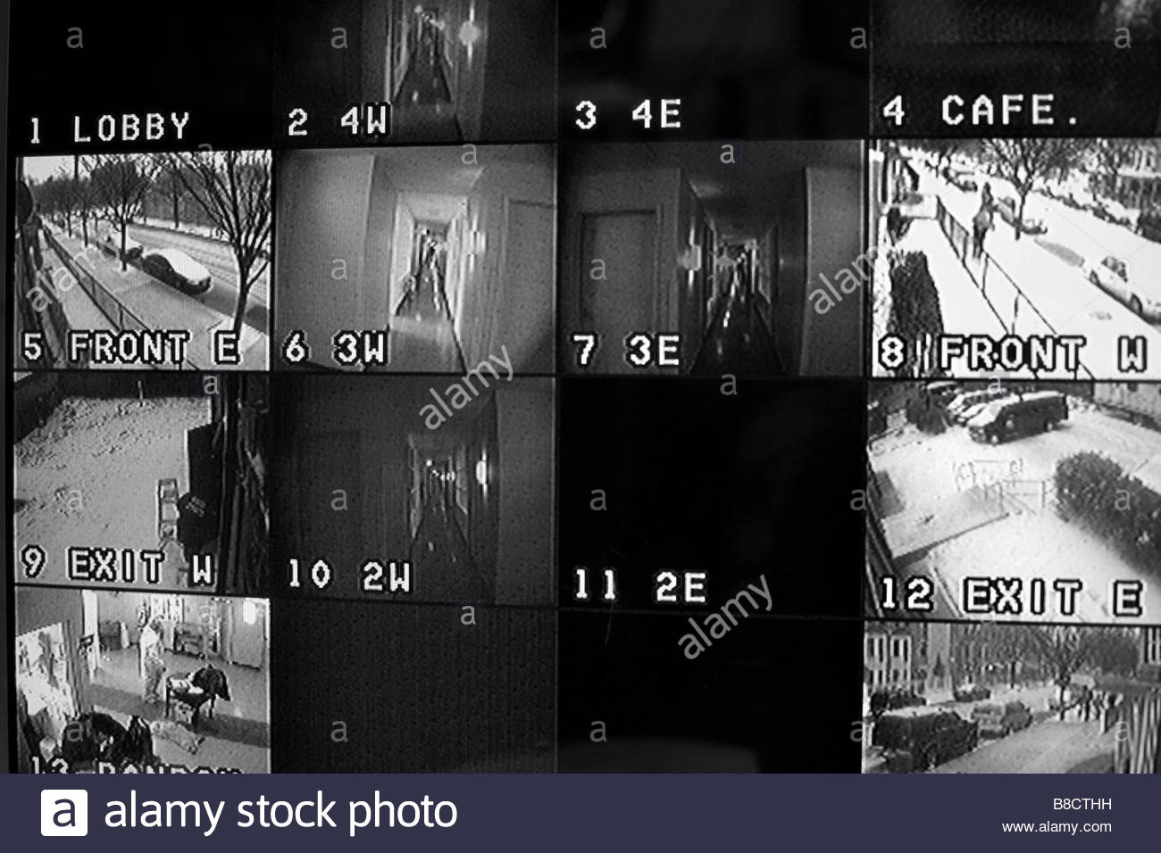
The question of whether it should have regulation is borne from a lot of negative press
based on its use in surveillance world.
Bad light
Bad angle
Hats/no hats - Beard/no Beard – Glasses/no Glasses – mask/no mask
Bad data gives bad results
Tech is good but data used to train is biased and bad

Slide 4
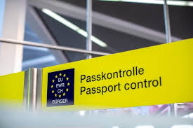
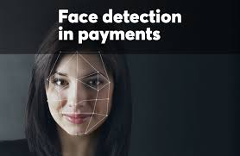
Benefits of facial
People forget the benefits. That gets drowned out. This is a wildly successful technology
that is used on a daily basis to make our lives easier.
Unlock phone – done
Make a payment – done
Open cars – done
Travel tickets – done
School role checks – done
Automation - done
And I think those benefits get lost in all the negativity because regulation kills innovation.

Slide 5
How we use facial regulation needs regulation

Slide 6
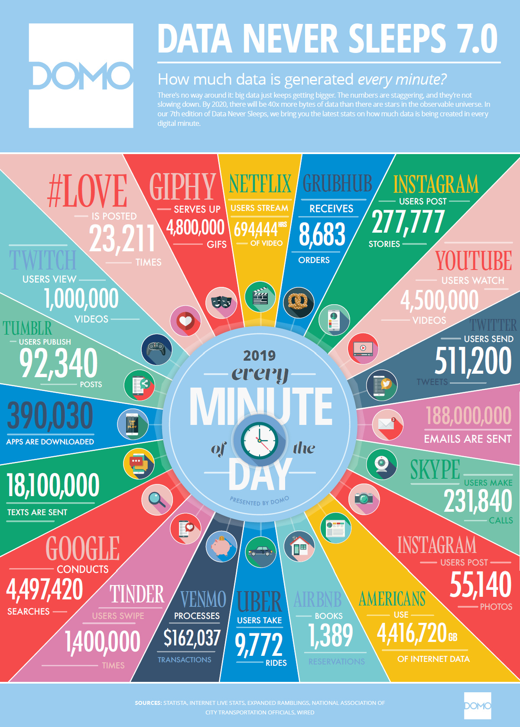
The tip of the iceberg…..
Not whether facial recognition needs regulation
but personal data usage needs regulation

